Slide 1
3-TIER ARCHITECTURE PROJECT

Slide 2
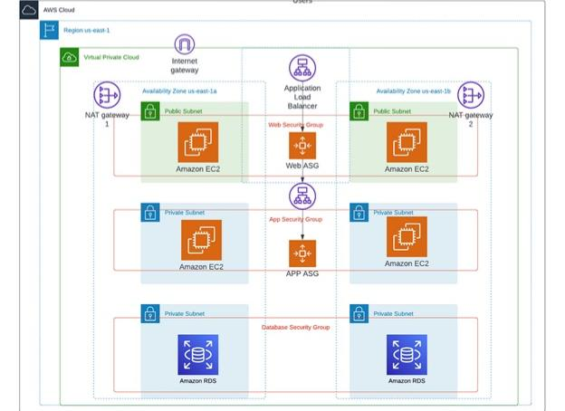

Slide 3
3-tier architecture is a well-established software architecture pattern that organizes applications into three logical and physical computing tiers: the presentation tier, the logic tier, and the data tier. This separation of concerns provides a modular structure for developing and maintaining software applications.
Presentation Tier: Also known as the user interface layer, this tier is responsible for displaying information to the user and handling user interactions.

Slide 4
Logic Tier: Also known as the application tier or business logic layer, this tier processes user inputs, makes logical decisions, and performs calculations. Data Tier: Also known as the database tier, this tier is responsible for storing, retrieving, and managing data. It’s essentials due to its nature: Modularity: Each tier can be developed, tested, and deployed independently. This modular approach makes the system more flexible and easier to manage. Scalability: The architecture allows for individual scaling of each tier. For example, if the presentation layer needs more resources due to increased user interactions, it can be scaled up independently of the logic or data layers.

Slide 5
Maintainability: By separating concerns, changes in one tier (e.g., a new UI design) can be made without affecting the other tiers. This reduces the risk of introducing bugs and makes maintenance more straightforward. Reusability: Logic and data tiers can be reused across different presentation tiers. For instance, the same backend can serve a web application, a mobile application, and a desktop application. Improved Performance: With the ability to distribute the workload across different servers, 3-tier architecture can improve the performance and response time of the application.

Slide 6
Let me explain you about the creation of VPC before the creation of 3-tier Architecture :
VPC named →
Two public subnets, distributed across two availability zones (Web Tier).
Two private subnets, distributed across two availability zones (Application Tier).
Two private subnets, distributed across two availability zones (Database Tier).
One public route table, linking the public subnets to an internet gateway.
One private route table, connecting the Application Tier private subnets to a NAT gateway.

Slide 7
Note: The VPC must have a /16 CIDR block, providing approximately 65,000 IP addresses. Each subnet must have a /24 CIDR block, offering around 256 IP addresses.

Slide 8
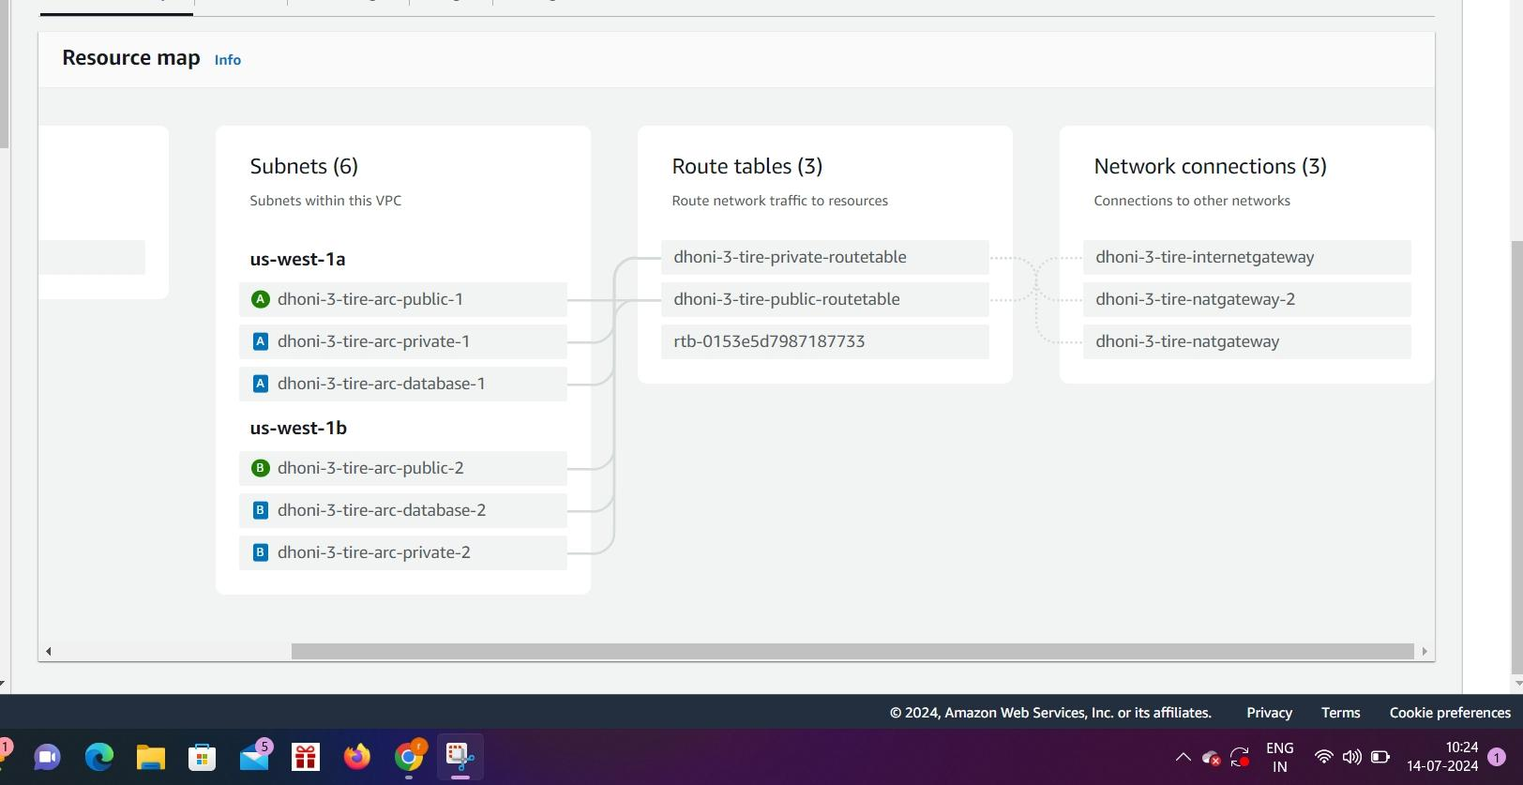

Slide 9
After successfully creating the VPC , the required subnets, and NAT gateway. Start the implementation of your 3-tier Architecture.
I have not included the creation of VPC and NAT gateway in this blog as it would have made it too long and boooring. If you’re interested in those details, please check out my other blogs, which cover the entire process. You can find the links above.

Slide 10
Tier1: WEB-TIER
The Web Tier, also referred to as the ‘Presentation’ tier, is the environment where users will interact with our application. For us, this tier will host our web servers, delivering the frontend of our application.

Slide 11
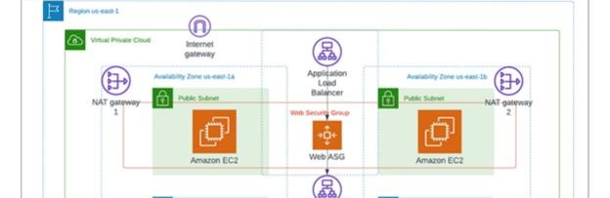

Slide 12
Components to be built:
EC2-launch template: A template to define what kind of EC2 instances need to be provisioned for the application.
Auto Scaling Group (ASG): An Auto Scaling Group (ASG) is a feature in Amazon Web Services (AWS) that automatically adjusts the number of Amazon Elastic Compute Cloud (EC2) instances in your application based on the current demand

Slide 13
Application Load Balancer (ALB): ALB is used to route traffic to different instances which are hosting out web-servers and helps reduce workloads on instances.
1.Creating a Template for ASG to Launch EC2 Instances Now, let’s create a template for our Auto Scaling Group (ASG) to dynamically launch EC2 instances in our public subnets.

Slide 14
In the EC2 console, go to the ‘Launch templates’ section under the ‘Instances’ sidebar menu.
Create a new template named ‘3-tier-webserver’ with the following specifications:
AMI: Amazon linux
Instance type: t2.micro

Slide 15
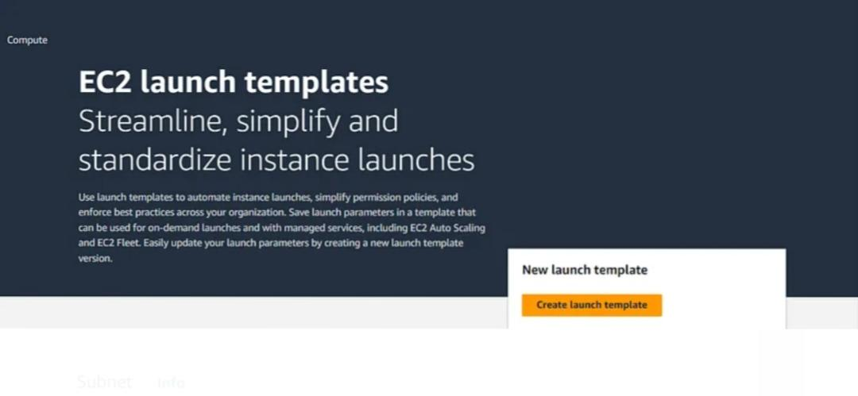

Slide 16
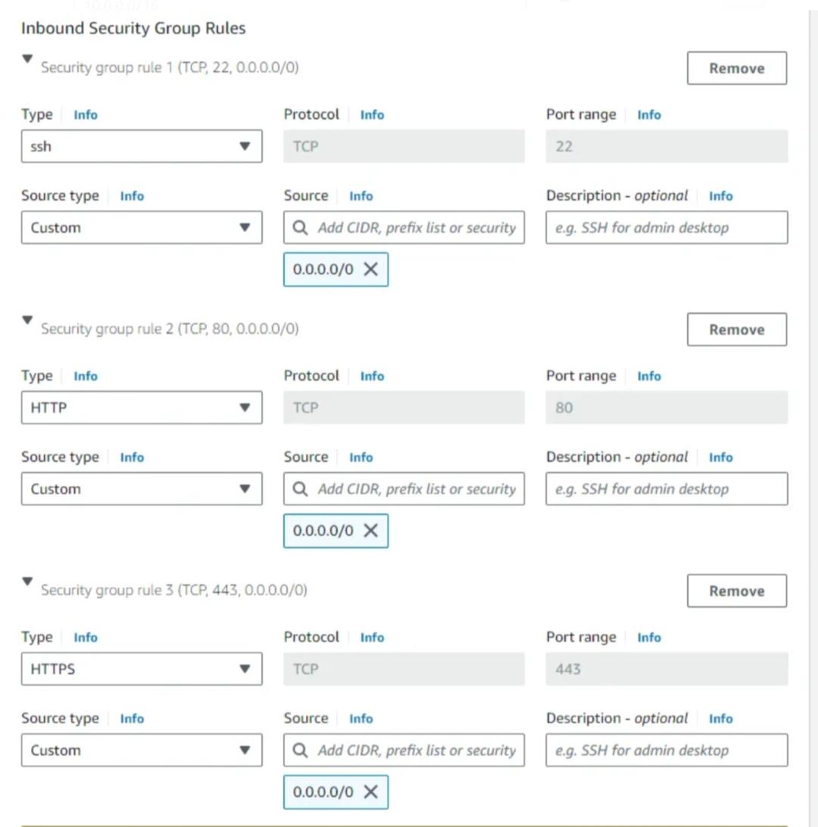

Slide 17
Configure the above Network Settings and Inbound rules as stated. Under Advanced Setting you will be having User Data option where you can provide the commands to run a web-server or upload a file. This option makes it easier and faster to run web-servers. After filling all the details click on create launch template.

Slide 18
2.Creating an Auto Scaling Group (ASG):
To ensure high availability for the application which is hosted on server, we will create an ASG that will dynamically provision EC2 instances, as needed, across multiple AZs in our public subnets.

Slide 19
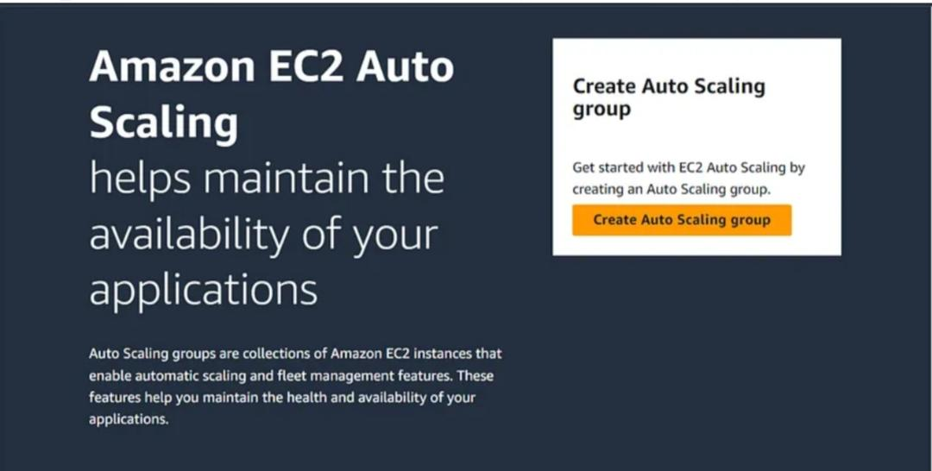

Slide 20
Navigate to the ASG console from the sidebar menu and create a new group named as 3-tier-ASG. The ASG will use the 3-tier-webserver-template launch template that we had set up in our previous step.
Select the medium-VPC along with the other two public subnets.

Slide 21
Navigate to the ASG console from the sidebar menu and create a new group named as 3-tier-ASG. The ASG will use the 3-tier-webserver-template launch template that we had set up in our previous step.
Select the medium-VPC along with the other two public subnets.

Slide 22
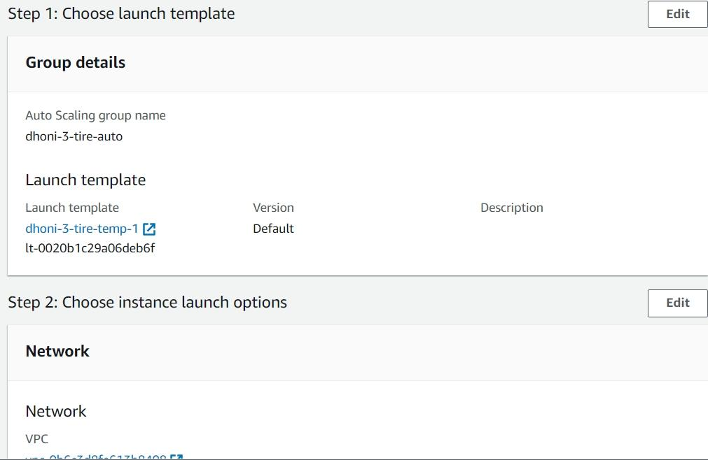

Slide 23
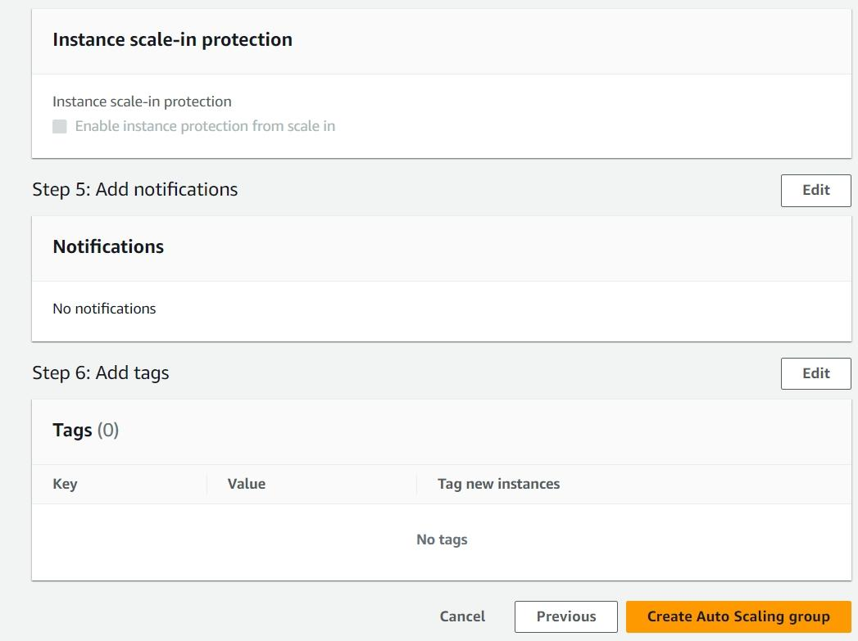

Slide 24
After selecting 3-tier-vpc as the desired VPC and its subnets in the Network configuration. The next step is to define the desired capacity of the instances in the particular subnets such as Desired capacity → 2, Minimum Desired capacity → 2, Maximum Desired capacity → 4
After Successfully launching the ASG make sure the instances are up and running. One instance in ap-south-1a and other in ap-south-1b

Slide 25
Creating an Application Load Balancer(ALB):
The next step in our first tier is creating an ALB. A load-balancer is basically used to divert/distributed the incoming traffic to the application equally among the instances. It can also be used to monitor the Health of your instances.

Slide 26
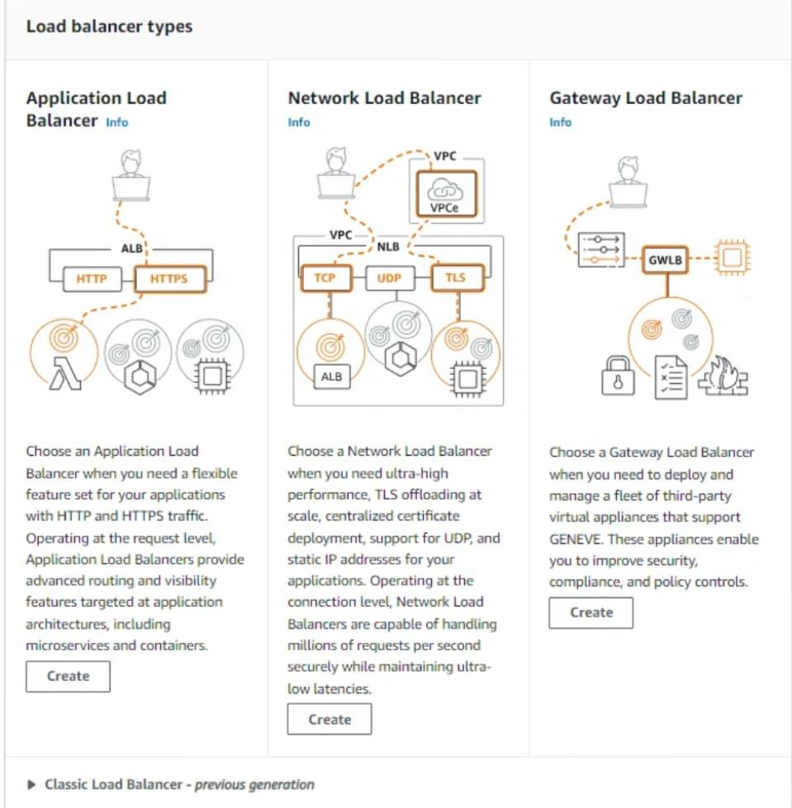

Slide 27
Our use-case requires an Application Load-Balancer, so select the ALB rather than NLB or GLB.
After selecting ALB, fill out the required details such as name and make sure you select ‘Scheme : Internet-facing’ as we need to allow the traffic from the internet to instances.

Slide 28
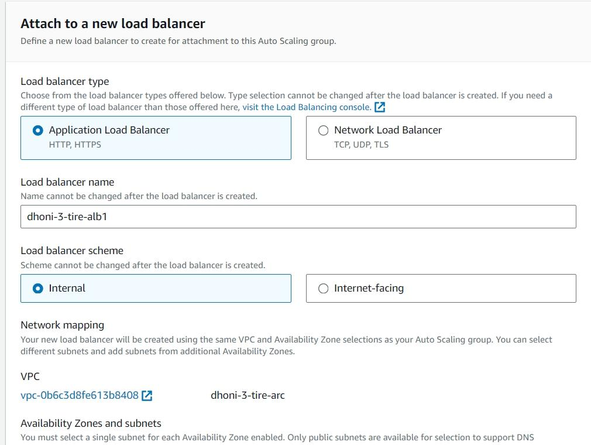

Slide 29
Under Network configuration, select the VPC which we have created prior and also select the subnets to which we need to divert the traffic from the Internet. In our case we have created 2-Instances one in ap-south-1a and other in ap-south-1b. Select these two AZs

Slide 30
Next we need to add listeners and routing, make sure you select the HTTP Protocol which is exposing the port 80 and here we also need to select the target-group. why target-group? target-group is used to indicate the Load-Balancer to divert the incoming traffic to the selected instances in the target-group.

Slide 31
Below is the process to create a target-group and add the registered-targets by selecting the required instances. Create target-group by naming it as 3-tier-tg. And later select the target-group which we have created(3-tier-tg) in Load-Balancer.

Slide 32
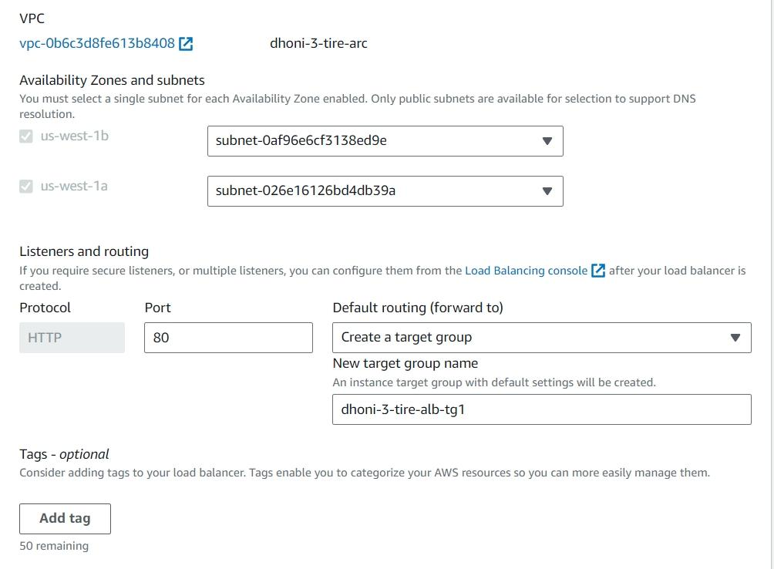

Slide 33
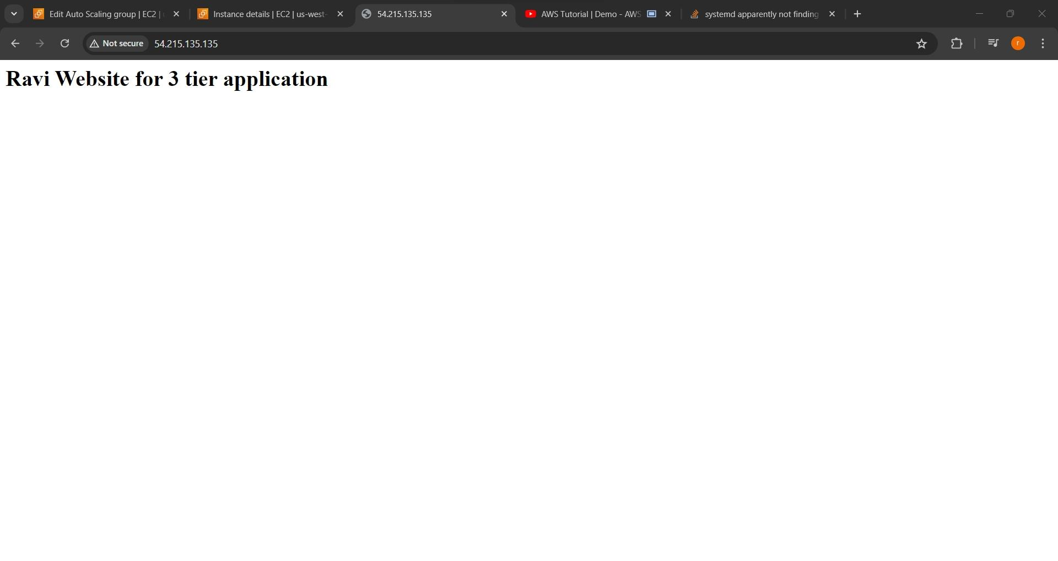

Slide 34
Success

Slide 35
Tier2 : Logic Tier
Logic Tier also known as Application-Tier is an important tier, that is why we have launched it in private sub-net. Application-Tier host our application code which is essential for our application to function
We are going to launch instances in our Application-tier the same way we have launched it in web-Tier, using Auto-Scaling Group (ASG).

Slide 36
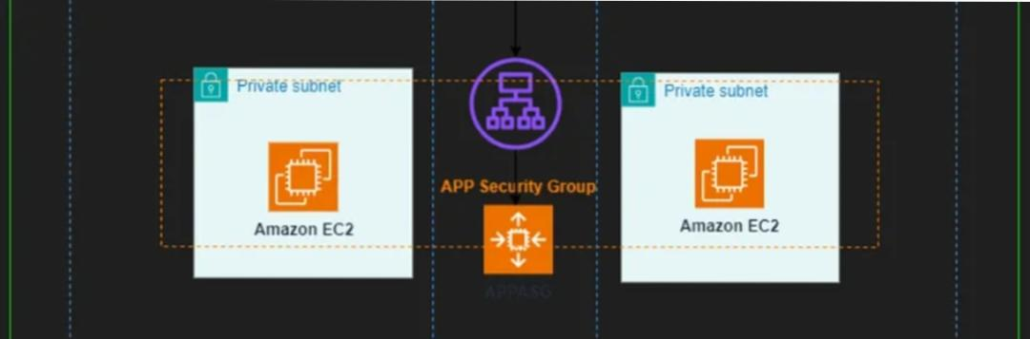

Slide 37
Components to be built:
EC2-launch template: A template to define what kind of EC2 instances need to be provisioned for the application.
Auto Scaling Group (ASG): An Auto Scaling Group (ASG) is a feature in Amazon Web Services (AWS) that automatically adjusts the number of Amazon Elastic Compute Cloud (EC2) instances in your application based on the current demand.

Slide 38
We can also create a Security-group specifically for application-tier instances, but i won’t be showing you that here.
→ Create a template named : ‘2nd-tier-template’ with the same previous configuration

Slide 39
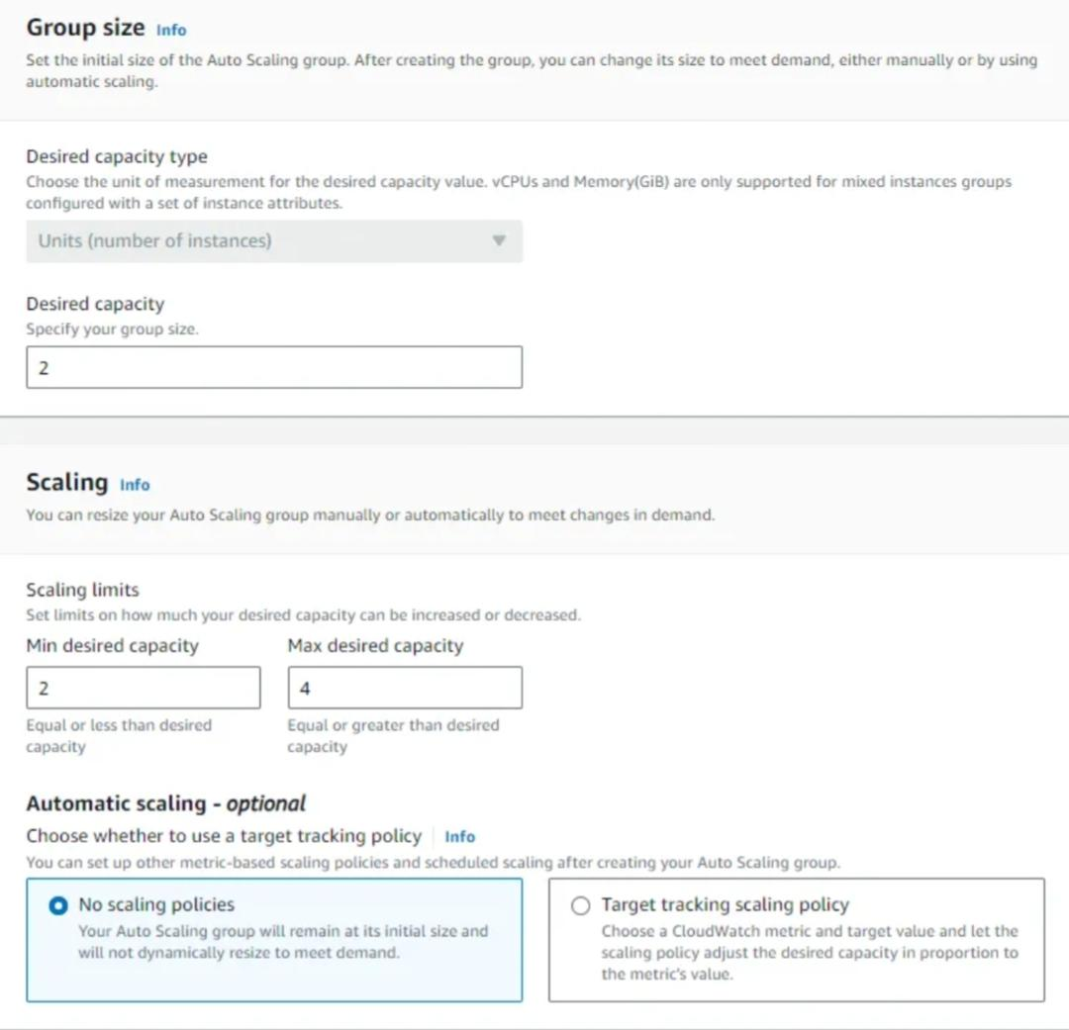

Slide 40
after selecting 3-tier-vpc as the desired VPC and its subnets in the Network configuration. The next step is to define the desired capacity of the instances in the particular subnets such as Desired capacity → 2, Minimum Desired capacity → 2, Maximum Desired capacity → 4
After Successfully launching the ASG make sure the instances are up and running. One instance in ap-south-1a(private) and other in ap-south-1b(private)

Slide 41
Now after successfully launching 2-instanes in 2-different AZs, you should be having four instances. 2 in public-subnet and the rest 2 in private-subnet.
To check the connectivity between the public-subnet and private-subnet, we can do this by using the ping <ip_address> . Below i have logged into the public instance and from this instance i’m using ping command to connect private instance. Make sure you use private-IPADDRESS of the instance of the private subnet as it only has private-IPADDRESS.
If ping is successful, you should get a response like below:

Slide 42
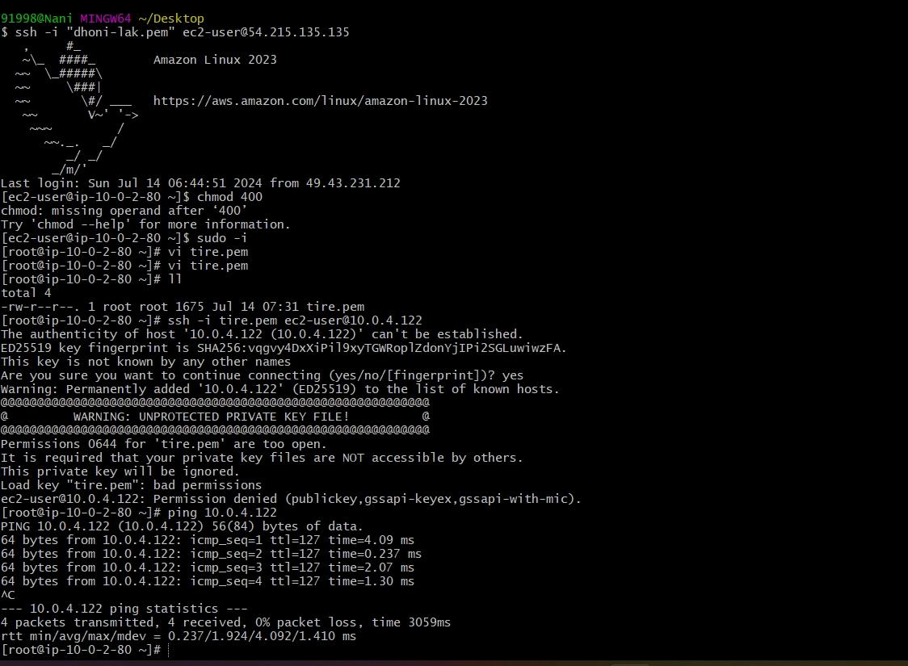

Slide 43
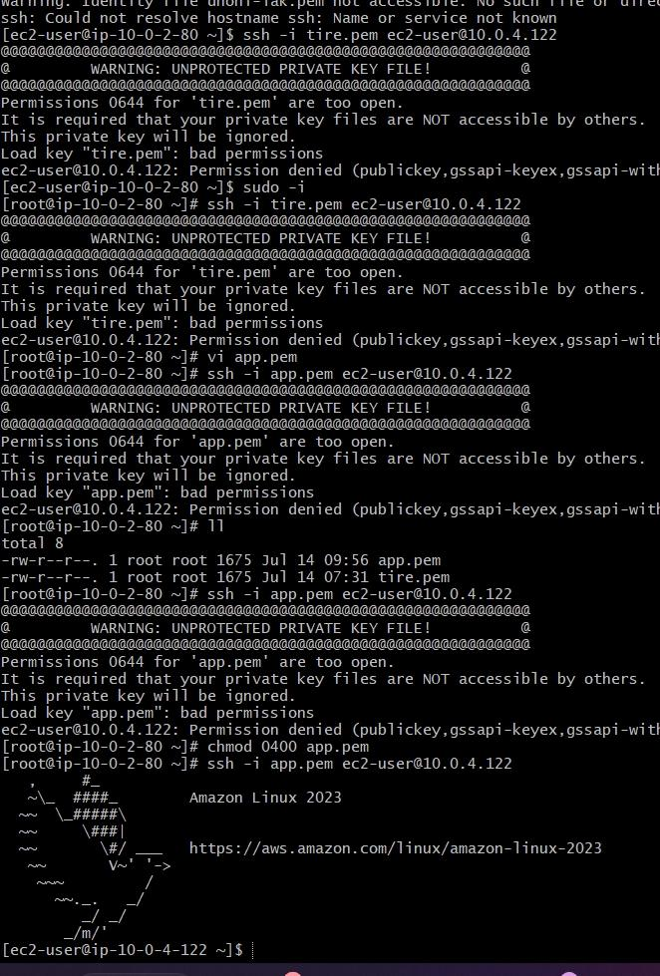

Slide 44
We have successfully pinged the app server and received a response from it. If you have lost packets, then there is an error to connect to your private instance from the public instance.

Slide 45
Tier3: Database Tier
The Database Tier is a critical component of a multi-tier architecture, responsible for storing and managing data used by an application. This tier typically comprises a database server that hosts the database management system (DBMS), which can be relational (e.g., MySQL, PostgreSQL) or non-relational (e.g., MongoDB, Cassandra).

Slide 46
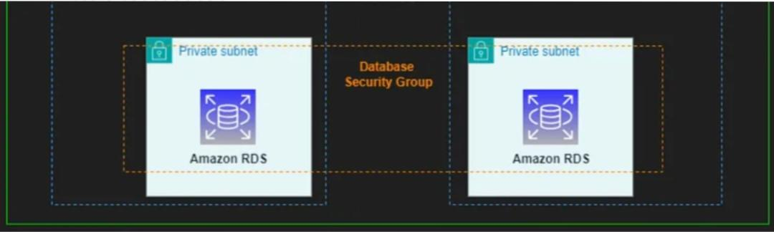

Slide 47
EC2-launch template: A template to define what kind of EC2 instances need to be provisioned for the application.
Auto Scaling Group (ASG): An Auto Scaling Group (ASG) is a feature in Amazon Web Services (AWS) that automatically adjusts the number of Amazon Elastic Compute Cloud (EC2) instances in your application based on the current demand.
We can also create a Security-group specifically for application-tier instances, but i won’t be showing you that here.
→ Create a template named : ‘2nd-tier-template’ with the same previous configuration

Slide 48
In the same-way create an Auto-scaling Group(ASG) naming it as : ‘2nd-tier-sg’, and select the template which we have created.

Slide 49
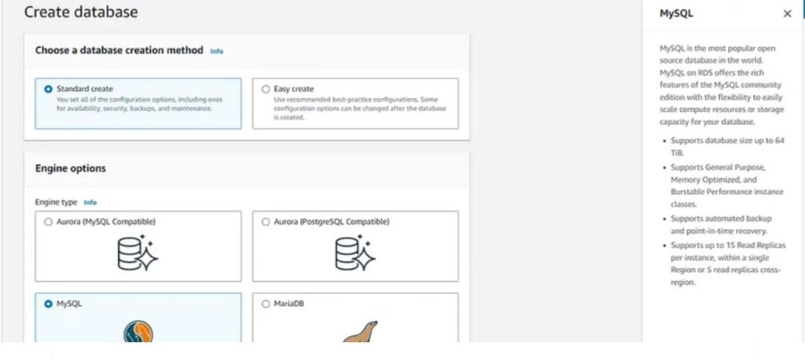

Slide 50
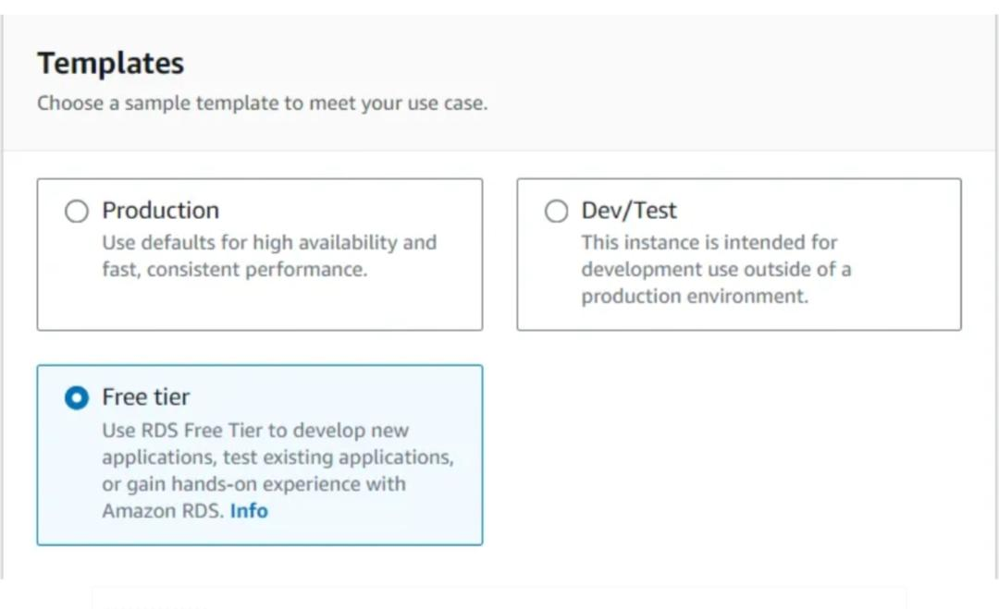

Slide 51
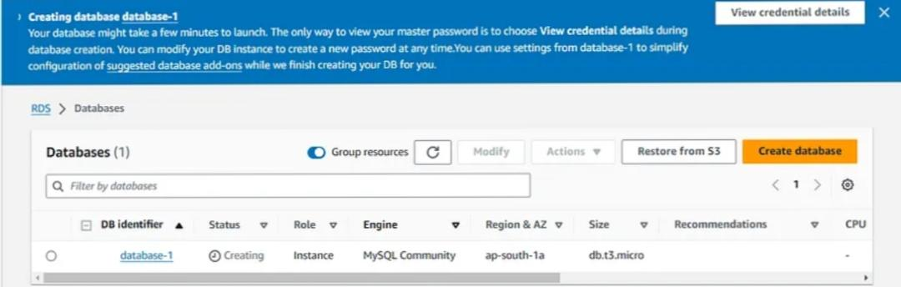

Slide 52
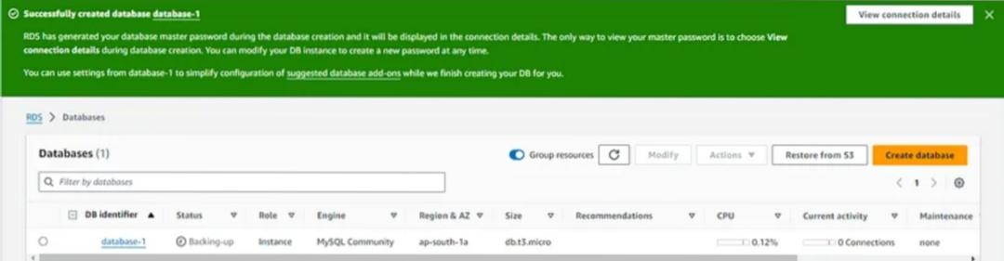

Slide 53
And remember to delete all the resources which we have created so far as we have completed our project and we have no use of it now!
We have successfully created a robust 3-tier architecture, effectively separating the Presentation, Application, and Database tiers.

Slide 54
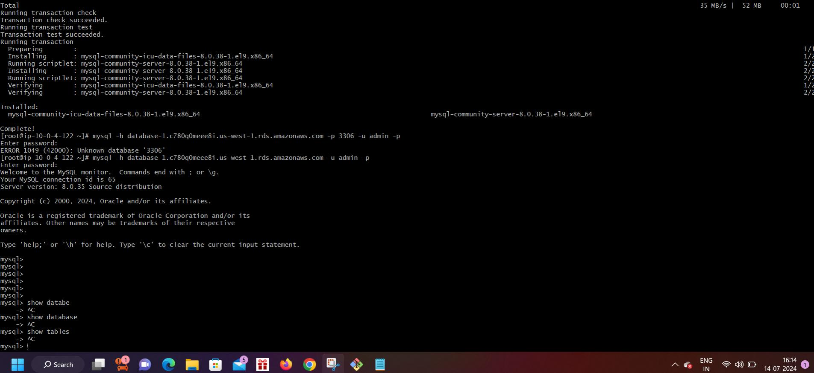

Slide 55
SUCCESS

